Slide 1
Introduction to Matlab
http//www.dcs.gla.ac.uk/~sumitha/

Slide 2
Matlab
Stands for MATrix LABoratory
Interpreted language
Scientific programming environment
Very good tool for the manipulation of matrices
Great visualisation capabilities
Loads of built-in functions
Easy to learn and simple to use
Introduction to Matlab

Slide 3
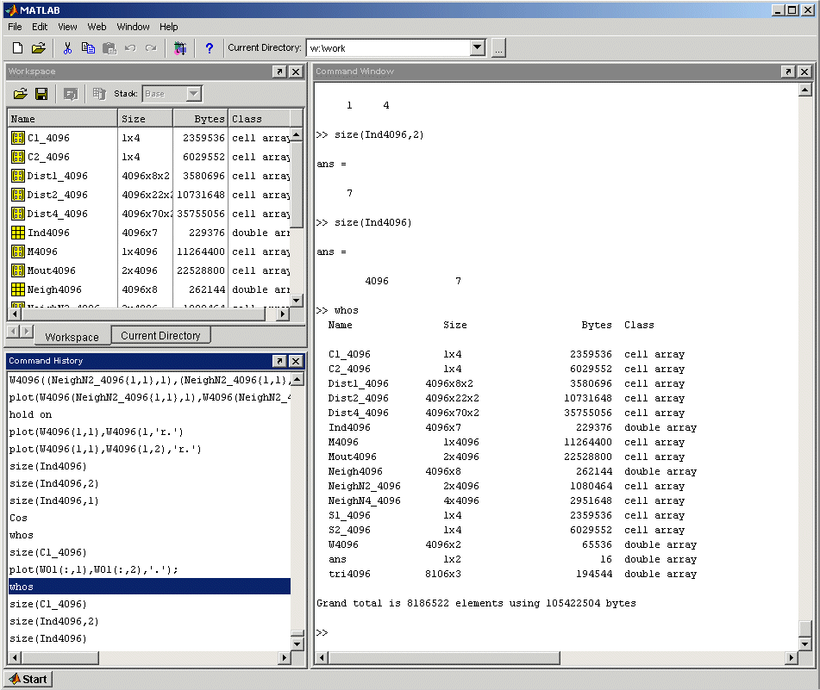

Matlab Desktop
Workspace / Current Directory
Command Window
Command History
Explore the Matlab Desktop
Introduction to Matlab

Slide 4
Variables
Don’t have to declare type
Don’t even have to initialise
Just assign in command window
>>
>> a=12; % variable a is assigned 12
Matlab prompt
comment operator
suppress command output
assign operator
Try the same line without the semicolon and comments
Introduction to Matlab

Slide 5
Variables (continued …)
View variable contents by simply typing the variable name at the command prompt
>> a
a =
12
>>
>> a*2
a =
24
>>
Introduction to Matlab

Slide 6
Workspace
The workspace is Matlab’s memory
Can manipulate variables stored in the workspace
>> b=10;
>> c=a+b
c =
22
>>
Introduction to Matlab

Slide 7
Basic Hand-On Exercise
Multiplying Digits 10 with 5
Store the result of a. in x.
Add 2 to the result of b.
Divide the sum of c. By 2 and store In y.
Add 1 to x, but don’t Display the Output.
Execute previous command again using the upper Arrow key.
Introduction to Matlab

Slide 8
Basic Hand-On Exercise
f) Was y variable recalculated when we changed the value of x
g) Declare a variable sq3 with value of 9.
h)Try clearing all variables by entering the command ‘clear’.
i) Try clearing the command window using ‘clc’.
Introduction to Matlab-

Slide 9
Workspace (continued …)
Display contents of workspace
>> whos
Name Size Bytes Class
a 1x1 8 double array
b 1x1 8 double array
c 1x1 8 double array
Grand total is 3 elements using 24 bytes
>>
Delete variable(s) from workspace
>> clear a b; % delete a and b from workspace
>> whos
>> clear all; % delete all variables from workspace
>> whos
Introduction to Matlab

Slide 10
Matlab help commands
help
>> help whos % displays documentation for the function whos
>> lookfor convert % displays functions with convert in the first help line
Start Matlab help documentation
>> helpdesk
Introduction to Matlab

Slide 11
Matrices
Don’t need to initialise type, or dimensions
>>A = [3 2 1; 5 1 0; 2 1 7]
A =
3 2 1
5 1 0
2 1 7
>>
square brackets to define matrices
semicolon for next row in matrix
Introduction to Matlab

Slide 12
Manipulating Matrices
A =
3 2 1
5 1 0
2 1 7
Access elements of a matrix
>>A(1,2)
ans=
2
Remember Matrix(row,column)
Naming convention Matrix variables start with a capital letter while vectors or scalar variables start with a simple letter
indices of matrix element(s)
Introduction to Matlab

Slide 13
The : operator
VERY important operator in Matlab
Means ‘to’
>> 1:10
ans =
1 2 3 4 5 6 7 8 9 10
>> 1:2:10
ans =
1 3 5 7 9
Try the following
>> x=0:pi/12:2*pi;
>> y=sin(x)
Introduction to Matlab

Slide 14
The : operator and matrices
>>A(3,2:3)
ans =
1 7
>>A(:,2)
ans =
2
1
1
A =
3 2 1
5 1 0
2 1 7
What’ll happen if you type A(:,:) ?
Introduction to Matlab

Slide 15
Manipulating Matrices
A =
3 2 1
5 1 0
2 1 7
>> A ' % transpose
>> B*A % matrix multiplication
>> B.*A % element by element multiplication
>> B/A % matrix division
>> B./A % element by element division
>> [B A] % Join matrices (horizontally)
>> [B; A] % Join matrices (vertically)
B =
1 3 1
4 9 5
2 7 2
Enter matrix B into the Matlab workspace
Create matrices A and B and try out the the matrix operators in this slide
Introduction to Matlab

Slide 16
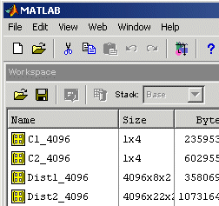
Scripts
Matlab editor
Use scripts to execute a series of Matlab commands
Matlab Desktop
Press to create new m-file in the matlab editor
Introduction to Matlab

Slide 17
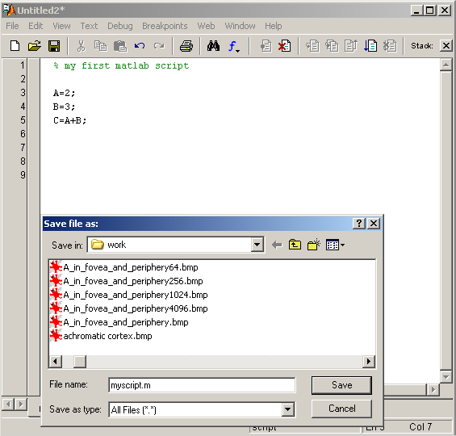
Scripts (continued)
Scripts will manipulate and store variables and matrices in the Matlab Workspace (memory).
They can be called from the Matlab command line by typing the (case sensitive!) filename of the script file.
>> myscript
Scripts can be opened in the editor by the following
>> open myscript
Will be slightly different in Linux
Highlight a few lines of your script by left- clicking and dragging the mouse over the lines. Right-click the highlighted lines and select Evaluate Selection.
Introduction to Matlab

Slide 18
Functions
Programming in Matlab.
Users can write functions which can be called from the command line.
Functions can accept input variable(s)/matrice(s) and will output variable(s)/matrice(s).
Functions will not manipulate variable(s)/matrice(s) in the Matlab Workspace.
In Matlab functions closely resemble scripts and can be written in the Matlab editor. Matlab functions have the function keyword.
Remember that the filename of a function will be its calling function name.
Don’t overload any built-in functions by using the same filename for your functions or scripts!
Functions can be opened for editing using the open command. Many built-in Matlab functions can also be viewed using this command.
Introduction to Matlab

Slide 19
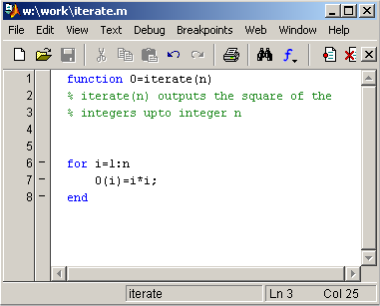
Functions (continued)
>> I=iterate(5)
I =
1 4 9 16 25
function name
input
output
function keyword
help lines for function
for statement block
Access the comments of your Matlab functions
>> help iterate
Make sure you save changes to the m-file before you call the function!
Introduction to Matlab

Slide 20
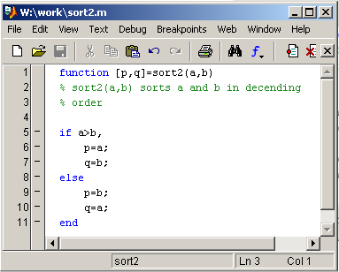
Functions (continued)
Functions can have many outputs contained in a matrix
>> [i j]=sort2(2,4)
i =
4
j =
2
>>
if statement block
Remember to use the Matlab help command for syntax
>> help if
Introduction to Matlab

Slide 21
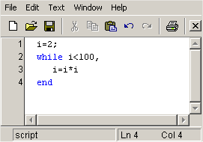
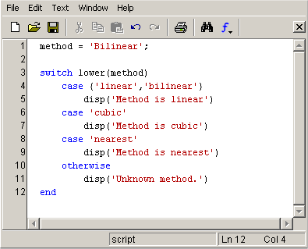
More flow control
While statement block
Switch statement block
Without ; to print output
i =
4
i =
16
i =
256
Method is linear
>>
Introduction to Matlab

Slide 22
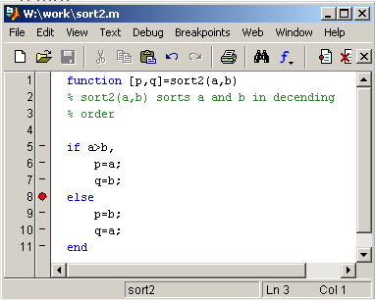
Debugging
Debug menus
Set breakpoints to stop the execution of code
>> [i j]=sort2(2,4)
K>>
K>> whos
Name Size Bytes Class
a 1x1 8 double array
b 1x1 8 double array
Grand total is 2 elements using 16 bytes
K>> a
a =
2
K>> return
i =
4
j =
2
local function workspace
exit debug mode
Click mouse on the left of the line of code to create a breakpoint
Introduction to Matlab

Slide 23
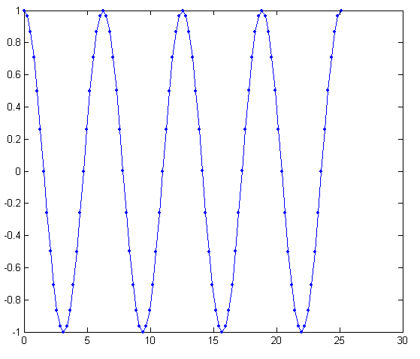
Visualisation - plotting data
>> figure % create new figure
>> t=0:pi/12:8*pi;
>> y=cos(t);
>> plot(t,y,‘b.-')
Plot style
Investigate the function
>> y=A*cos(w*t+phi);
for different values of phi (eg: 0, pi/4, pi/3, pi/2), w (eg: 1, 2, 3, 4) and A (eg: 1, 0.5, 2). Use the hold on Matlab command to display your plots in the same figure. Remember to type hold off to go back to normal plotting mode. Try using different plot styles (help plot)
A = amplitude
phi = phase
w = angular frequency = 2*pi*frequency
Introduction to Matlab

Slide 24
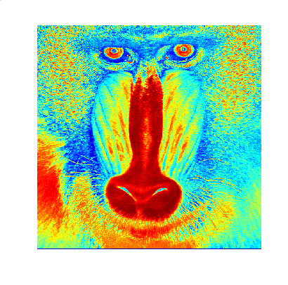
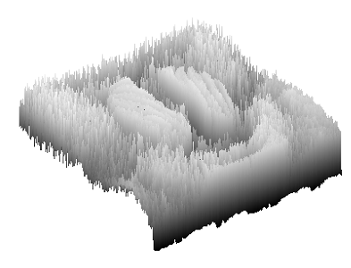
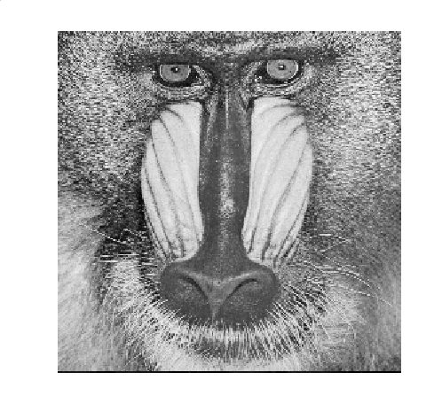
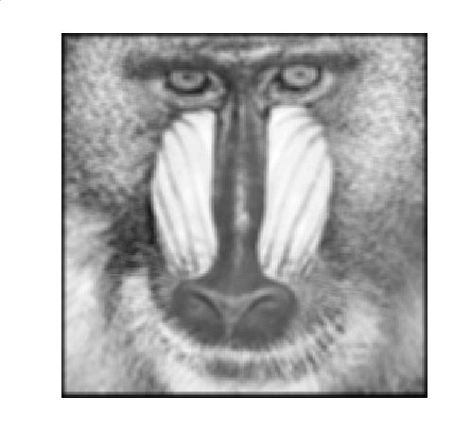
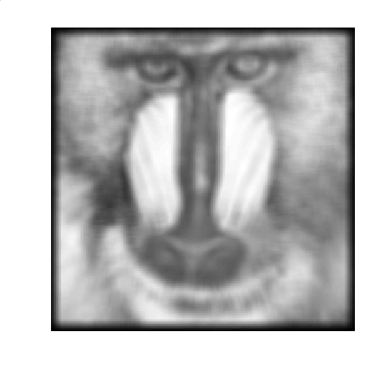


Image Processing using Matlab
Introduction to Matlab

Slide 25

Useful operators and built-in functions
< ¦ save !
> rand load guide
~= zeros … get
== min ' ' set
>= max { }
<= repmat try
& axis catch
Operating system command
Continue in next line
Graphical user interface
string
cell
error handling
Remember to use the Matlab help command if you get stuck
Introduction to Matlab

Slide 26
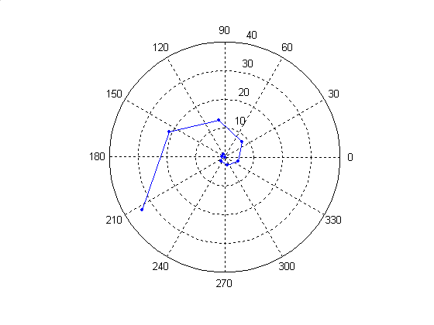
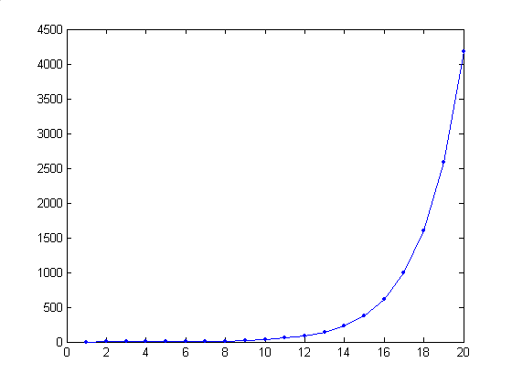
Tutorial 1
Login to your workstation, start Matlab and create a working directory
  Login to Linux using your username/password
  Open a terminal session by right clicking the mouse on the screen and selecting New Terminal
  Type the following in the terminal session (do not type the prompt sign > )
> matlab
> mkdir work
  4) Type the following in Matlab (do not type the prompt sign >> )
>> cd work
Explore Matlab! Use the help matlab command to understand the built-in Matlab functions
Type the code in this handout in Matlab and investigate the results.
Write a Matlab function fibonacci.m to generate the Fibonacci series. This is generated by starting with zero and one and adding the last two numbers of the sequence to generate the next number in the series. Fibonacci series:
0, 1, 1, 2, 3, 5, 8, 13, 21, 34, 55, 89, 144, 233, 377, 610, 987, ...
Create an graph of the Fibonacci series using the built-in plot Matlab function. Your graph should resemble figure 1 which contains a plot of the first 20 numbers in the sequence.
Plot the Fibonacci series in polar coordinates using the built-in Matlab polar function. Eccentricity (rho) should be the Fibonacci number and angle (theta) should vary with the Fibonacci number’s order in the sequence. Your plot should resemble figure 2 which is a polar plot of the first 10 numbers of the series.
Exit Matlab by typing quit and logout of Linux.
>> quit
Figure 1
Figure 2
Introduction to Matlab

